Slide 1
Data Communication and Networking (DCAN 202)
Week 5

Slide 2
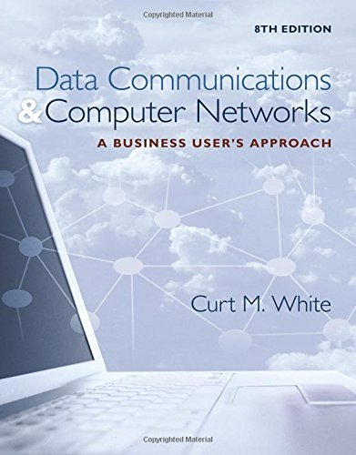
Chapter 7, 8: Local Area Networks
Data Communications and Computer Networks: A Business User's Approach, Eighth Edition
© 2016. Cengage Learning. All right reserved.

Slide 3
Todays Lecture
Definition of a Local Area Network (LAN)
List the primary function, activities, and application areas of a LAN
Cite the advantages and disadvantages of LANs
Identify the physical and logical layouts (topologies) of LANs
Various medium access control techniques
Various IEEE 802 frame formats
Common local area network systems
Compare and contrast wireless LANs to wired LANs
Identify the main functions of network operating systems
Compare and contrast the Windows Server family, Unix, Linux, and Mac OS X Server network operating systems

Slide 4
Introduction
A local area network is a communication network that interconnects a variety of data communicating devices within a small geographic area and broadcasts data at high data transfer rates
Since the local area network first appeared in the 1970s, its use has become widespread in commercial and academic environments

Slide 5
Primary Function of Local Area Networks
To provide access to hardware and software resources that will allow users to perform one or more of the following activities:
Access to the Internet
File serving
A large storage disk drive acts as a central storage repository
Print serving
Providing the authorization to access a particular printer, accept and queue print jobs, and providing a user access to the print queue to perform administrative duties
Database and application serving
Data Communications and Computer Networks: A Business User's Approach, Eighth Edition
© 2016. Cengage Learning. All Rights Reserved.

Slide 6
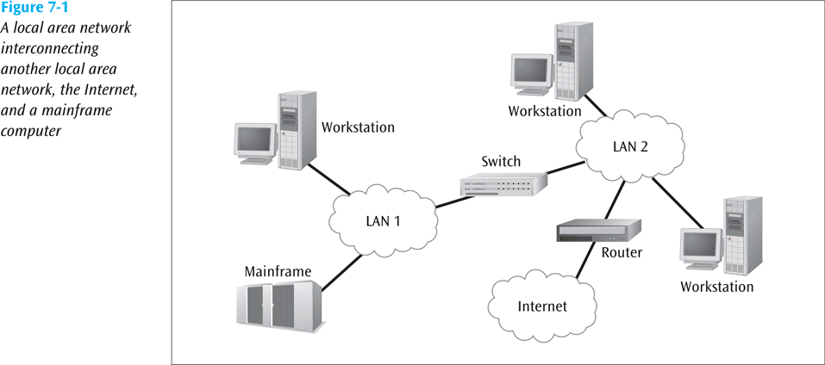
Primary Function of Local Area Networks
To provide access to hardware and software resources that will allow users to perform one or more of the following activities:
Manufacturing support
LANs can support manufacturing and industrial environments
Academic support
In classrooms, labs, and wireless
E-mail serving
Interconnection between multiple systems
A Local Area Network interconnecting another local area network, the internet, and a mainframe computer
Data Communications and Computer Networks: A Business User's Approach, Eighth Edition
© 2016. Cengage Learning. All Rights Reserved.

Slide 7
Advantages and Disadvantages of Local Area Networks
Advantages
Ability to share hardware and software resources
Individual workstation might survive network failure
Component and system evolution are possible
Support for heterogeneous forms of hardware and software
Access to other LANs and WANs (Figure 7-1)
Private ownership (maybe a disadvantage)
Secure transfers at high speeds with low error rates
Disadvantages
Equipment and support can be costly
Level of maintenance continues to grow
Private ownership (lease option attractive for some)
Some types of hardware may not interoperate
Just because a LAN can support two different kinds of packages does not mean their data can interchange easily
LAN is only as strong as its weakest link, and there are many links
Data Communications and Computer Networks: A Business User's Approach, Eighth Edition
© 2016. Cengage Learning. All Rights Reserved.

Slide 8
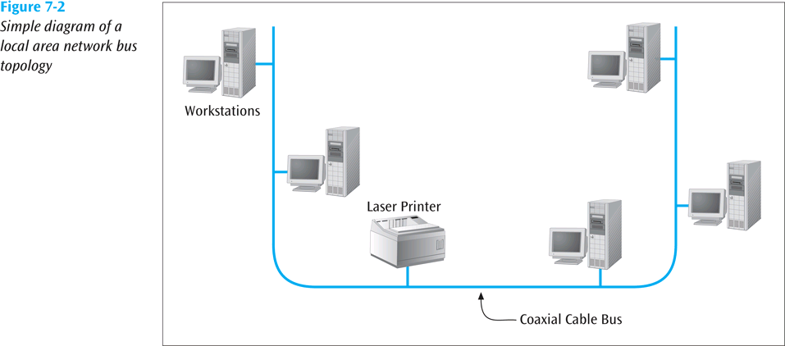
The First Local Area Network: The Bus/Tree
The original topology
Workstation has a network interface card (NIC) that attaches to the bus (a coaxial cable) via a tap
Data can be transferred using either baseband digital signals or broadband analog signals
Baseband signals are bidirectional and more outward in both directions from the workstation transmitting
Broadband signals are usually unidirectional and transmit in only one direction
Because of this, special wiring considerations are necessary
Buses can be split and joined, creating trees
Simple diagram of a local area network bus topology
Data Communications and Computer Networks: A Business User's Approach, Eighth Edition
© 2016. Cengage Learning. All Rights Reserved.

Slide 9
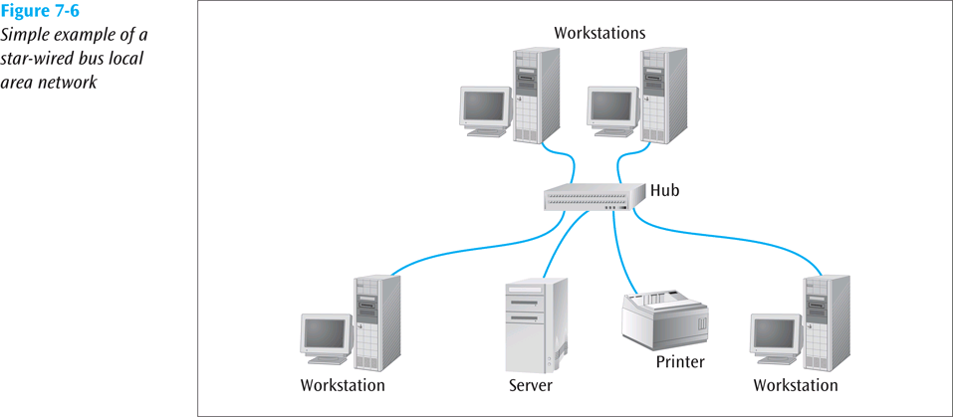
A More Modern LAN : The Star-Wired Bus
Logically operates as a bus, but physically looks like a star
Star design is based on hub
All workstations attach to hub
Unshielded twisted pair usually used to connect workstation to hub
Originally, hub takes incoming signal and immediately broadcasts it out all connected links
Hubs can be interconnected to extend size of network
Simple example of a star-wired bus LAN
Data Communications and Computer Networks: A Business User's Approach, Eighth Edition
© 2016. Cengage Learning. All Rights Reserved.

Slide 10
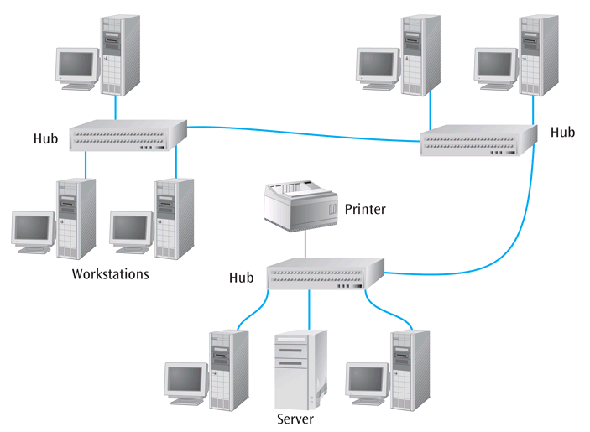
Star-Wired Bus (continued)
Modular connectors and twisted pair make installation and maintenance of star-wired bus better than standard bus
Hubs can be interconnected with twisted pair, coaxial cable, or fiber-optic cable
Biggest disadvantage: when one station talks, everyone hears it
This is called a shared network
All devices are sharing the network medium
Interconnection of three hubs in a star wired bus LAN
Data Communications and Computer Networks: A Business User's Approach, Eighth Edition
© 2016. Cengage Learning. All Rights Reserved.

Slide 11
Medium Access Control Protocols
How does a workstation get its data onto the LAN medium?
A medium access control protocol is the software that allows workstations to “take turns” at transmitting data
Two basic categories:
Contention-based protocols
Round-robin protocols
Data Communications and Computer Networks: A Business User's Approach, Eighth Edition
© 2016. Cengage Learning. All Rights Reserved.

Slide 12
Contention-Based Protocols
Essentially first-come, first-served
Most common example is carrier sense multiple access with collision detection (CSMA/CD)
If no one is transmitting, workstation can transmit
If someone else is transmitting, workstation “backs off” and waits
If two workstations transmit at same time, collision occurs
When two workstations hear collision, they stop transmitting immediately
Each workstation backs off a random amount of time and tries again
Hopefully, both workstations do not try again at exact same time
CSMA/CD is an example of a non-deterministic protocol
Data Communications and Computer Networks: A Business User's Approach, Eighth Edition
© 2016. Cengage Learning. All Rights Reserved.

Slide 13
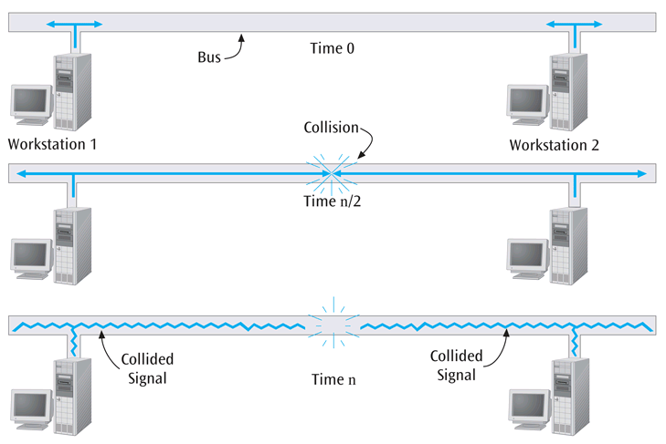
Contention-Based Protocols (continued)
Two workstations at opposite ends of a bus experiencing a collision
Data Communications and Computer Networks: A Business User's Approach, Eighth Edition
© 2016. Cengage Learning. All Rights Reserved.

Slide 14
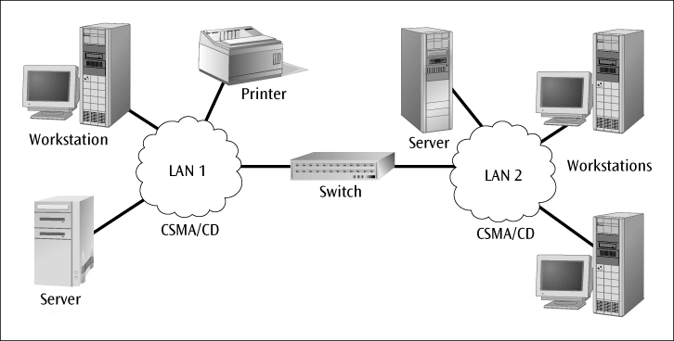
Switches
The hub is a simple device that transmits an incoming frame out all the other ports on the hub
The switch has intelligence and can filter out and forward frames based on their NIC address
A switch maintains internal port table(s) that keep track of which frames arrived on which ports
Switches have eliminated many hubs
A switch interconnecting two LANs
Data Communications and Computer Networks: A Business User's Approach, Eighth Edition
© 2016. Cengage Learning. All Rights Reserved.

Slide 15
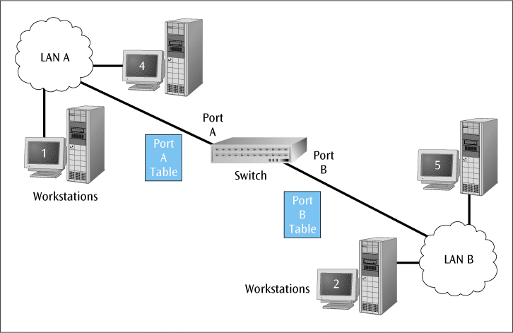
Switches (continued)
A switch observes each frame that arrives at a port, extracts the source address from the frame, and places that address in the port’s routing table
A transparent switch is found with CSMA/CD LANs
Workstations that connect to a hub are on a shared segment
Workstations that connect to a switch are on a switched segment
The backplane of a switch is fast enough to support multiple data transfers at one time
A switch interconnecting two LANs has two internal port tables
Data Communications and Computer Networks: A Business User's Approach, Eighth Edition
© 2016. Cengage Learning. All Rights Reserved.

Slide 16
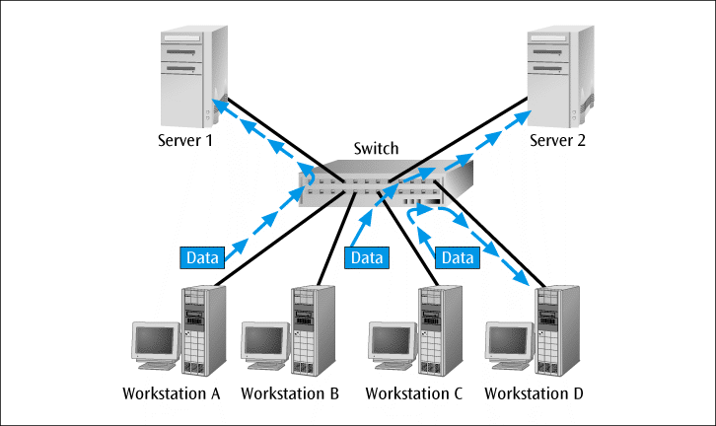
Switches (continued)
A switch that employs cut-through architecture is passing on frame before entire frame has arrived at switch
Multiple workstations connected to a switch use dedicated segments
This is a very efficient way to isolate heavy users from the network
Switches can allow simultaneous access to multiple servers, or multiple simultaneous connections to a single server
A switch with two servers allowing simultaneous access to two servers
Data Communications and Computer Networks: A Business User's Approach, Eighth Edition
© 2016. Cengage Learning. All Rights Reserved.

Slide 17
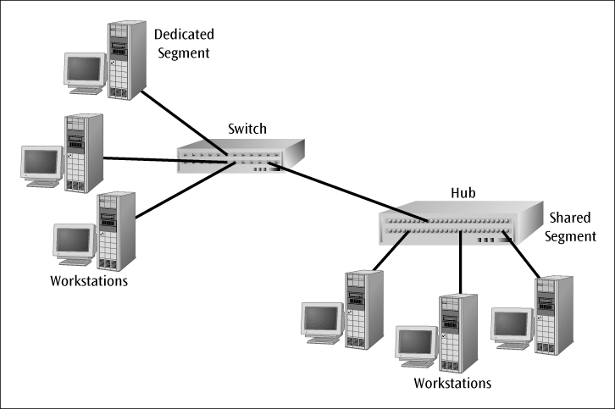
Isolating Traffic Patterns and Providing Multiple Access
Whether shared or dedicated segments are involved, the primary goal of a switch is to isolate a particular pattern of traffic from other patterns of traffic or from the remainder of the network
Switches, because of their backplane, can also allow multiple paths of communications to simultaneously occur
Workstations connected to a shared segment local area network
Data Communications and Computer Networks: A Business User's Approach, Eighth Edition
© 2016. Cengage Learning. All Rights Reserved.

Slide 18
Full-Duplex Switches
Allow for simultaneous transmission and reception of data to and from a workstation
This full-duplex connection helps to eliminate collisions
To support a full-duplex connection to a switch, at least two pairs of wires are necessary
One for the receive operation
One for the transmit operation
Most people install four pairs today, so wiring is not the problem
Data Communications and Computer Networks: A Business User's Approach, Eighth Edition
© 2016. Cengage Learning. All Rights Reserved.

Slide 19
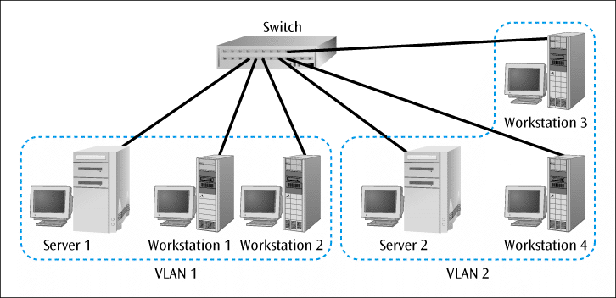
Virtual LANs
Virtual LAN (VLAN) – logical subgroup within a LAN that is created via switches and software rather than by manually moving wiring from one network device to another
Even though employees and their actual computer workstations may be scattered throughout the building, LAN switches and VLAN software can be used to create a “network within a network”
A relatively new standard, IEEE 802.1Q, was designed to allow multiple devices to intercommunicate and work together to create a virtual LAN
Instead of sending technician to a wiring closet to move a workstation cable from one switch to another, an 802.1Q-compliant switch can be remotely configured by a network administrator
A switch with two VLANs configured
Data Communications and Computer Networks: A Business User's Approach, Eighth Edition
© 2016. Cengage Learning. All Rights Reserved.

Slide 20
Link Aggregation
Allows you to combine two or more links into one higher-speed link
Why would we want to do this?
What if you want more bandwidth between a device and a switch?
What if you want to provide a back-up link between a device and a switch?
What if you want to provide a higher-speed connection to a server?
An IEEE protocol (802.3ad-2000) which typically runs in most LAN devices can support link aggregation
Link aggregation attempts to balance the flow of messages over the multiple paths, unless the flow of frames belong to a particular conversation; then the frames are sent over one of the links.
Data Communications and Computer Networks: A Business User's Approach, Eighth Edition
© 2016. Cengage Learning. All Rights Reserved.

Slide 21
Spanning Tree Algorithm
What if you have a large set of networks interconnected with many switches?
Because of this large set of networks, a loop has been created in which a frame can circle through the networks and actually return to the originating device
The spanning tree algorithm (used in Spanning Tree Protocol and now Rapid Spanning Tree Protocol) runs in switches and can identify loops and remove them
Data Communications and Computer Networks: A Business User's Approach, Eighth Edition
© 2016. Cengage Learning. All Rights Reserved.

Slide 22
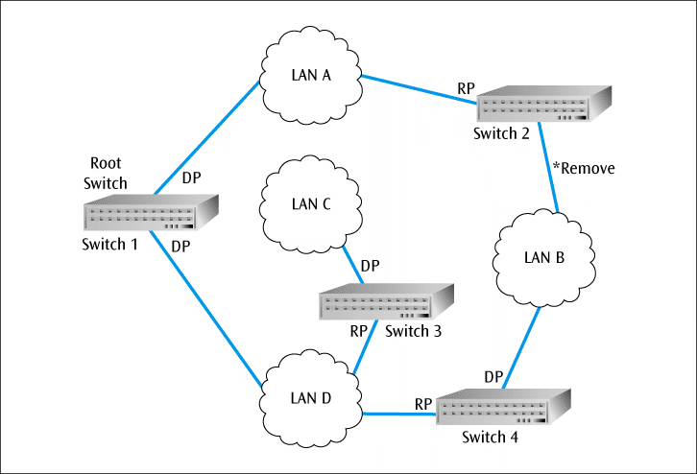
Spanning Tree Algorithm
How does the spanning tree algorithm work? Four steps:
Identify a switch as the root switch
Visit each switch and identify the one port that has the shortest path back to the root switch. Mark these ports with RP (root port)
Visit each LAN and identify the port that provides the shortest path back to the root switch. Mark these ports with a DP (designated port).
Are there any ports remaining that don’t have either an RP or DP designation? Mark those ports as Removed. (They aren’t physically removed, only removed in the forwarding tables)
Network interconnection indicating root switch, root ports, designated ports, and removed connections
Data Communications and Computer Networks: A Business User's Approach, Eighth Edition
© 2016. Cengage Learning. All Rights Reserved.

Slide 23
Quality of Service
On a standard Ethernet LAN, all frames have the same priority, which is none
What if you want to make video-conferencing frames a higher priority than email frames?
You can use IEEE 802.1p standard which is installed in most if not all switches
The 802.1p standard adds a 3-bit field to the front of each Ethernet frame
This 3-bit field can be used to establish a priority
Data Communications and Computer Networks: A Business User's Approach, Eighth Edition
© 2016. Cengage Learning. All Rights Reserved.

Slide 24
Wired Ethernet
Most common form of LAN today
Star-wired bus is most common topology but bus topology still not totally dead yet
Comes in many forms depending upon medium used and transmission speed and technology
Originally, CSMA/CD was 10 Mbps
Then 100 Mbps was introduced
Most NICs sold today are 10/100 Mbps
Then 1000 Mbps (1 Gbps) was introduced
10 Gbps is now being installed in high-end applications
40 Gbps (GbE) and 100 GbE are now appearing in high-end switches and networks
1000 Mbps introduced a few interesting wrinkles:
Transmission is full-duplex (separate transmit and receive), thus no collisions
Prioritization is possible using 802.1p protocol
Topology can be star or mesh (for trunks)
Data Communications and Computer Networks: A Business User's Approach, Eighth Edition
© 2016. Cengage Learning. All Rights Reserved.

Slide 25
Wired Ethernet (continued)
One of the more recent features is power over Ethernet (PoE)
What if you have a remote device that has an Ethernet connection?
It will require a power connection
What if you don’t have an electrical outlet nearby?
Use PoE
Power to drive Ethernet NIC is sent over wiring along with usual Ethernet signals
Data Communications and Computer Networks: A Business User's Approach, Eighth Edition
© 2016. Cengage Learning. All Rights Reserved.

Slide 26
LANs In Action: A Small Office Solution
What type of system will interconnect 20 workstations in one room and 15 workstations in another room to a central server, which offers:
Internal e-mail
A database that contains all customer information
High-quality printer access
Data Communications and Computer Networks: A Business User's Approach, Eighth Edition
© 2016. Cengage Learning. All Rights Reserved.

Slide 27
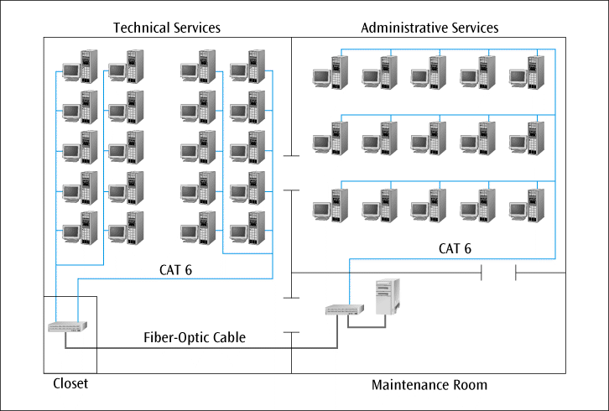
LANs In Action: A Small Office Solution (continued)
Wiring diagram of an office space showing the placement of switches and servers
Data Communications and Computer Networks: A Business User's Approach, Eighth Edition
© 2016. Cengage Learning. All Rights Reserved.

Slide 28
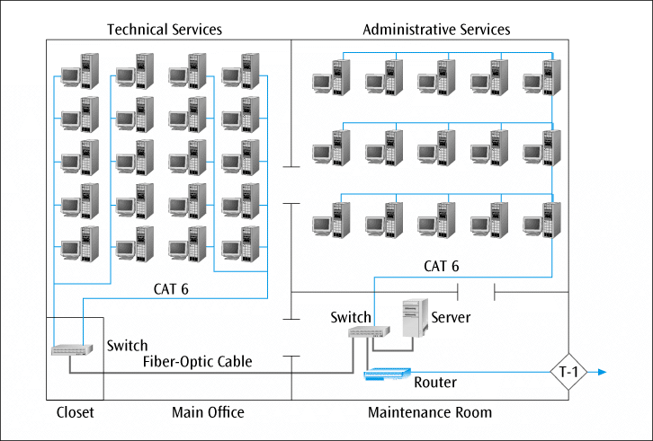
LANs In Action: A Small Office Solution (continued)
The modified network with a router and high-speed phone line
Data Communications and Computer Networks: A Business User's Approach, Eighth Edition
© 2016. Cengage Learning. All Rights Reserved.

Slide 29
Wireless Ethernet
Not really a specific topology
Workstation in a wireless LAN can be anywhere as long as it is within transmitting distance to an access point
Several versions of IEEE 802.11 standard define various forms of wireless LAN connections (we’ll take a look at these versions in a little bit)
Two basic components necessary:
Client radio
Usually a PC card with an integrated antenna installed in a laptop or workstation
Access point (AP)
An Ethernet port plus a transceiver
Access point acts as a bridge between the wired and wireless networks and can perform basic routing functions
Workstations with client radio cards reside within Basic Service Set, while multiple basic service sets create an Extended Service Set
Data Communications and Computer Networks: A Business User's Approach, Eighth Edition
© 2016. Cengage Learning. All Rights Reserved.

Slide 30
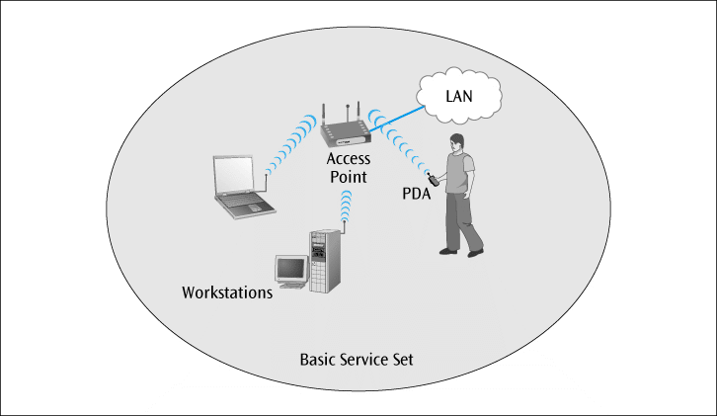
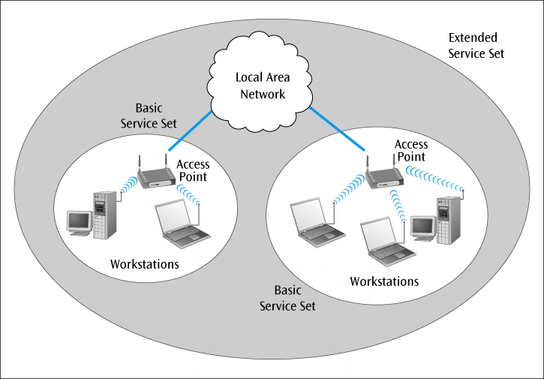
Wireless Ethernet
A single-cell wireless LAN configuration
A multiple-cell wireless LAN configuration
Data Communications and Computer Networks: A Business User's Approach, Eighth Edition
© 2016. Cengage Learning. All Rights Reserved.

Slide 31
Wireless Ethernet
With directional antennae designed for point-to-point transmission (rare), 802.11b can transmit for more than 10 miles
With an omni-directional antenna on typical AP, range may drop to as little as 100 feet
IEEE 802.11n (100 Mbps theoretical) is the latest standard to be approved
802.11n uses MIMO technology (multiple input multiple output)
Sender and receiver have multiple antennas for optimum reception
802.11ac uses advanced MIMO, wider channels in the 5 GHz band and advanced QAM techniques to achieve high data rates
To provide security, most systems use either:
Wired Equivalent Privacy (WEP) – provides either 40- or 128-bit key protection (dated)
WPA or WPA 2 (Wi-Fi Protected Access)
WPA 2 uses the most advanced encryption techniques
Wireless LANs may also be configured without an access point
These configurations are called “ad-hoc”
Data Communications and Computer Networks: A Business User's Approach, Eighth Edition
© 2016. Cengage Learning. All Rights Reserved.

Slide 32
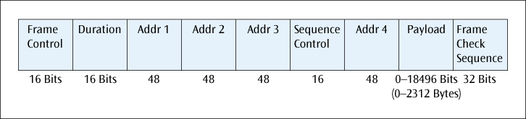
Wireless CSMA/CA [carrier sense multiple access with collision avoidance]
CA (Collision avoidance)
Protocol does not listen and detect collisions like CSMA/CD
Instead, tries to avoid collisions before they happen
How does CSMA/CA do this?
All devices, before they transmit, must wait an amount of time called an interframe space (IFS)
Some applications have a short IFS, while others have a long IFS
If two applications want to transmit at same time, the application with shorter IFS will go first
Note that the frame format for wireless Ethernet(CSMA/CA) has four address fields:
The various fields of the CSMA/CA frame
Data Communications and Computer Networks: A Business User's Approach, Eighth Edition
© 2016. Cengage Learning. All Rights Reserved.

Slide 33
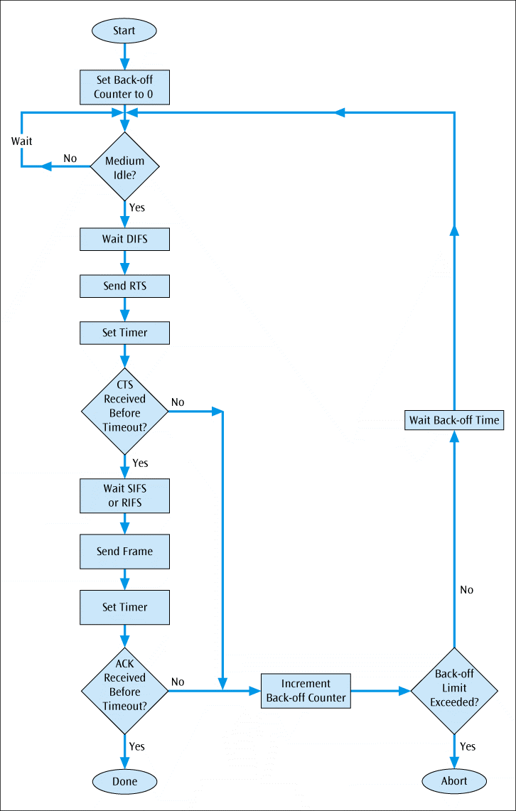
Flowchart showing the algorithm for CSMA/CA
Data Communications and Computer Networks: A Business User's Approach, Eighth Edition
© 2016. Cengage Learning. All Rights Reserved.

Slide 34
LAN Support
Proper support of a local area network requires hardware, software, and miscellaneous support devices
Network OS is the most important software component
Several popular network OSs currently exist:
Windows Server family
Unix
Linux
NetWare derivatives
Numerous network support programs are also required to support users on a LAN
Support devices such as hubs, switches, routers, servers, modems, power supplies, and more are also necessary
Data Communications and Computer Networks: A Business User's Approach, Eighth Edition
© 2016. Cengage Learning. All Rights Reserved.

Slide 35
Network Operating Systems
An OS manages all applications and resources in a computer
Multitasking OS supports execution of multiple processes at one time
Network OS is large, complex program that manages the resources common on most local area networks; client OS such as Windows 7 can perform some networking functions
Besides performing standard OS functions, a network OS is called upon for additional functions, such as:
Manage one or more network servers
Manage one or more network printers
Manage the interconnection between LANs
Manage locally connected users
Manage remotely connected users
Support system security
Support client/server functions
Support Web page development and Web server operations
Data Communications and Computer Networks: A Business User's Approach, Eighth Edition
© 2016. Cengage Learning. All Rights Reserved.

Slide 36
Windows Server 2019
The latest version of Windows network OS
New server core (including a virtual server)
Self-healing server that can fix corrupted files and/or folders
Increased processing speed
Advancements in network security
Data Communications and Computer Networks: A Business User's Approach, Eighth Edition
© 2016. Cengage Learning. All Rights Reserved.

Slide 37
Unix
Well established and very popular multitasking OS capable of supporting network operations
First OS written in the language C
Very stable system capable of supporting very large operations
Numerous versions available from different vendors
Data Communications and Computer Networks: A Business User's Approach, Eighth Edition
© 2016. Cengage Learning. All Rights Reserved.

Slide 38
Linux
OS based on the principles of Unix.
Many versions available for free (Free Software Foundation’s GNU toolset) or very small price
Very stable multitasking OS
When incorporated with other free software products, such as the Apache Web server and Atipa’s BlueBird network management software, this system becomes extremely cost effective and powerful
Data Communications and Computer Networks: A Business User's Approach, Eighth Edition
© 2016. Cengage Learning. All Rights Reserved.

Slide 39
Mac OS X Server
Apple Computer finally joined the NOS market with its Mac OS Server
Version X is based on Linux code
Very stable and quite powerful
While installed primarily in Apple networks, Mac OS X Server is also capable of supporting non-Apple networks
Data Communications and Computer Networks: A Business User's Approach, Eighth Edition
© 2016. Cengage Learning. All Rights Reserved.

Slide 40
Network Servers
In order to support a network OS, you need one or more network servers
Network servers are high-power workstations often with multiple processors, RAID, SCSI, and lots of memory and disk space
Various forms of servers include server appliances, and server blades
Server virtualization allows you to create multiple servers in software all running on a single physical server
To protect the server from catastrophic disk failure, disk drives on most network servers support one of the redundant array of independent disks (RAID) techniques
RAID is a collection of techniques for interfacing multiple hard disk drives to a computer
Data Communications and Computer Networks: A Business User's Approach, Eighth Edition
© 2016. Cengage Learning. All Rights Reserved.

Slide 41
Client/Server Networks vs. Peer-to-Peer Networks
A clear majority of LANs are client/server networks
A client/server network has one or more network servers supporting the operations of one or more clients, or user workstations
Peer-to-peer networks also exist
May have servers, but the network relies less on the servers and more on the communications between workstations
Data Communications and Computer Networks: A Business User's Approach, Eighth Edition
© 2016. Cengage Learning. All Rights Reserved.

Slide 42
Server Software
Software necessary to support server side of Internet connections
Retrieves Web pages and other documents when asked to by a client workstation
Can interface with database program allowing users to store and retrieve data via Internet
Necessary with commercial Internet applications
Data Communications and Computer Networks: A Business User's Approach, Eighth Edition
© 2016. Cengage Learning. All Rights Reserved.

Slide 43
Software Licensing Agreements
Virtually every commercial software program comes with a specific licensing agreement
Most licensing agreements specify the following conditions:
Software installation and use
Network installation
Backup copies
Decompilation
Rental statement
Upgrade availabilities
Copyright restrictions
Maintenance agreements
Most licensing agreements come in one of the following forms:
Single-user-single-station license
Single-user-multiple-station license
Interactive user license
Network server license
Site license
Corporate license
Data Communications and Computer Networks: A Business User's Approach, Eighth Edition
© 2016. Cengage Learning. All Rights Reserved.

Slide 44
LANs In Action: A Home Office Solution
Sam has three computers at home and wants all three to share a printer and a connection to the Internet
What are some of the questions that Sam has to answer before he can start purchasing and/or installing something?
Data Communications and Computer Networks: A Business User's Approach, Eighth Edition
© 2016. Cengage Learning. All Rights Reserved.

Slide 45
LANs In Action: A Home Office Solution
Many decisions to make when installing a wireless LAN
Which IEEE 802.11 format?
802.11a?
Fast (54 Mbps), uses higher frequencies
802.11g?
Fast (54 Mbps), compatible with 802.11b
802.11n or ac?
Latest standards (100+Mbps)
What type of wireless access point do you need?
If you already have a wired network (with router and modem), all you need is a basic wireless access point
If you don’t have a home network but have a high-speed Internet connection, you will need a wireless router
If you don’t even have a high-speed Internet connection yet, you might want to consider a wireless gateway.
What type of network OS do you need?
Do you need something as powerful as Windows 2012 Server?
No, you only need a client OS such as latest Windows desktop OS, Apple Mac OS, or Linux
Data Communications and Computer Networks: A Business User's Approach, Eighth Edition
© 2016. Cengage Learning. All Rights Reserved.

